Slide 1

Summary Project
Book Ratings Big Database Analysis
Analyst Team
October 19, 2022

Slide 2



Our team
Adam
Aminadav
Gal
Apache Pilot
Zookeeper
Map Reducer

Slide 3
The Process
01. Files
02. Hadoop Ecosystem
3 Large Data files from the “Book Crossing Dataset”
To Clean Big Data files, we used a Hadoop framework.
03. ETL on Spark
04. Data Visualization Tableau
Spark and Pyspark Were used to extract, transform and load the data
After Data was clean, Data was uploaded to tableau for analysis and visualization

Slide 4

Introduction
This project involved a thorough clean of an old database of books and book ratings with more than 1.5 Million rows across 3 files. We were given the task of cleaning the data, fixing and preparing it for analysis. Because of the large file sizes, we used our Hadoop platform and completed a full ETL protocol on Spark. Subsequent Model was analyzed with Tableau, and we’d like to present the findings here today.

Slide 5
The Files
CSV
We received 3 databases with data BX-Book-Ratings, BX-Books, and BX-Users.
All the database we received was with data unstructured we split the data into column according to there label some of the column we needed to understand what was the label of the column from the data that inside.
In BX-Book-Ratings exist a table with data of users rating books from 0 to 10.
In BX-Books exist table with data of the book that published over the years.
In BX-Users exist a table with data about users location and their age.

Slide 6
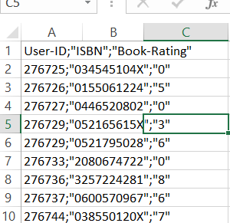
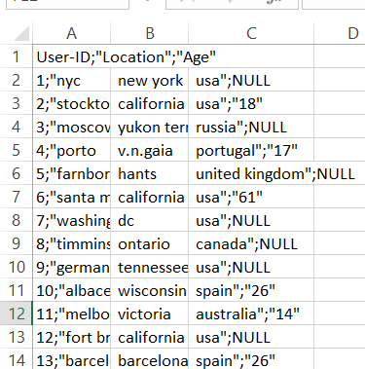
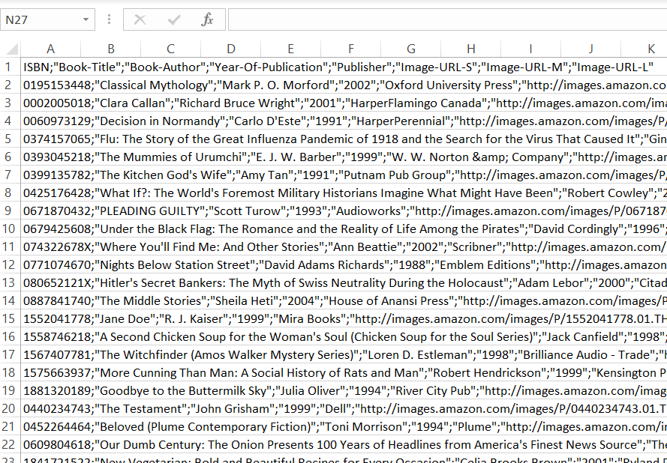
Quick Look At The Raw Data
Looks pretty good, very minor problems
Location is spread across three columns, wrong delimiters, extra values in rows
Delimiters in wrong places, columns either fused or not, split columns creating domino effect

Slide 7
The Clean (ETL)
Spark
Hooked up to the Hadoop Platform.
Lot of Messy Data, Columns were not divided uniformly, many delimiters in wrong places, proving a challenge for normalization.
We started by splitting columns in unique ways for each column depending on the column circumstance.
standard protocol executed for removing nulls, empty values, improbable values, junk values, and values in wrong columns (i.e. alphanumeric values in columns meant only for alphabetical values and vice versa).
Fuzzy geographical Data such as varying titles for the same country, were unified however not in a totally satisfactory manner. filtering was done in Tableau to compensate.
Built an algorithm to validate ISBN (International Serial Book Numbers) in the database and removed data with wrong values.
After the data was ready to go, we quickly created the Model using standard SQL queries and PySpark.
Model consisted of: Dim Books, Dim Users, Fact Rating.

Slide 8
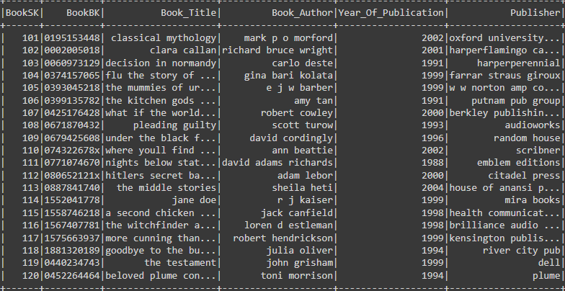
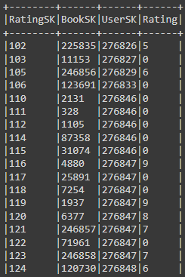
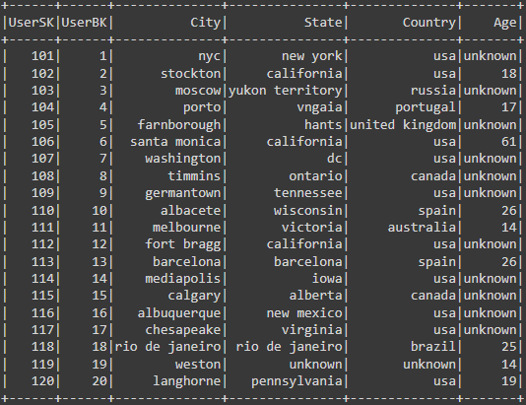
Our Model
Dim Books
All the Relevant Book Data
Dim Users
All The Relevant User Data
Fact Rating
Rating with keys to the dimensions

Slide 9
Preparing the Report
Tableau
We downloaded the tables from Spark into a csv file and called the tables by their names with Dim and Fact.
We wanted a good data visualization tool, so we chose Tableau to visualize the data.
Our data consisted of much geographical data and in terms of time, available to us was the publishing year data.
1st Dashboard was made with general data on database and key data on top books, authors and publishers
2nd Dashboard Shows rating data according to geographical location
3rd Dashboard shows data according to publishing years
Much time was spent creating measures, parameters, tooltips, and relationships.
Many Filters were made to totally eliminate any other erroneous values. (Countries)
Measures were identified with an ‘I’ or ‘E’ or both to identify them as including Explicit measures and/or Implicit Measures

Slide 10
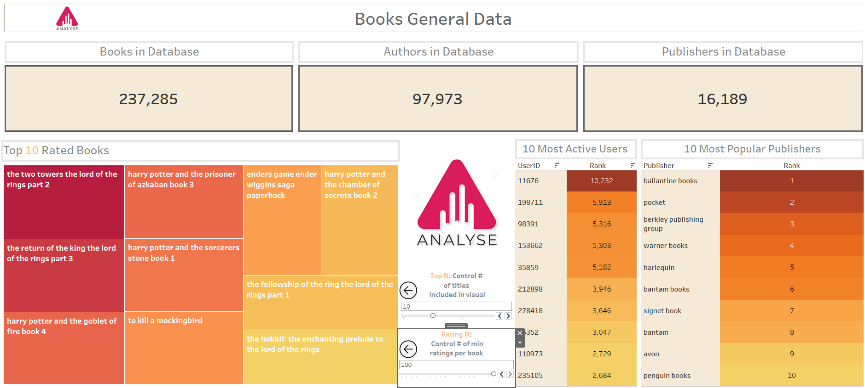
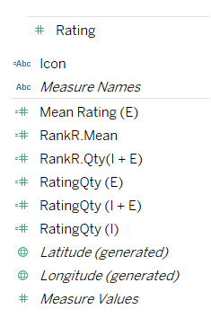
The Report
Dashboard #1 General
General Info
Measures
Notice ‘I’ and ‘E’ Signifiers
Parameters
To decide how many books to show and decide minimum rating quantity required

Slide 11
Findings
Geographical Data
Most of the ratings came from the US and Canada, so generalizing findings is not without risk
Top authors did vary across Countries to some degree, even between US and Canada
Local authors did impact popularity, for example Spain's top ten authors included Spanish writing authors.
Iran surprisingly contributed over 1000 ratings to the database, highest in all the middle east
Australia most avid readers in the pacific with over 14,000 ratings compared to China’s 550.
And our own Israel with a humble 200 ratings

Slide 12
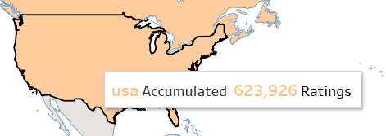
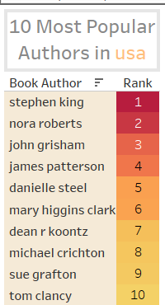
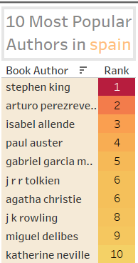
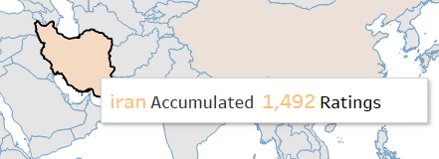
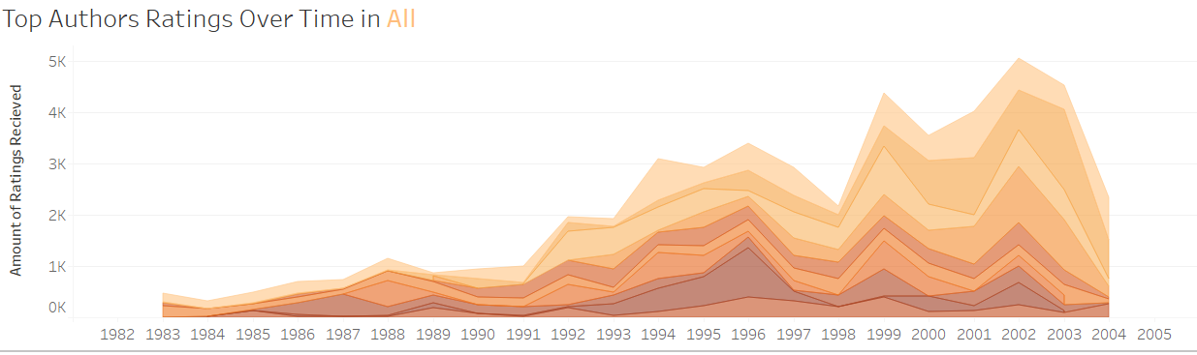
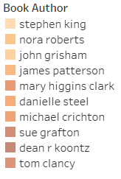
The Geographical Data
USA on top as always
Highest in the middle east!
Trends of top authors
Data is heavily skewed by US
More Local Authors

Slide 13
Findings
Publishing Year Data
Although there was much competition in terms of book publications prior to 1985, ‘Harlequin’ remains the most proficient publisher since.
Books Prior to 1980 usually read most by people in their 20’s while more recent books are read most by people in their 30’s.
Although Teens and Children don’t represent much of the database, They at times read as much old titles (prior 1940) as other age groups, and sometimes even the largest demographics of readers.

Slide 14
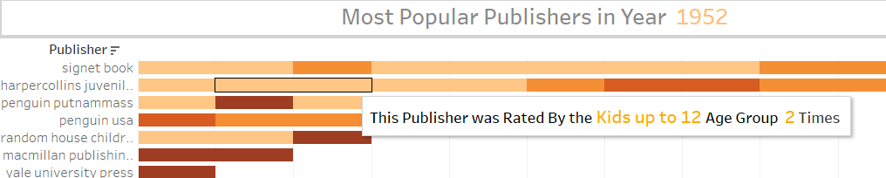
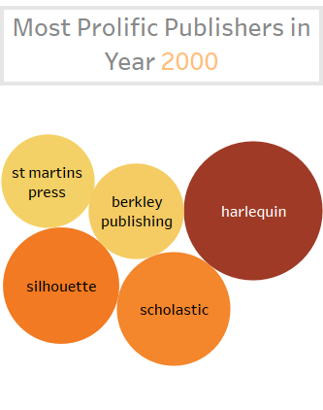
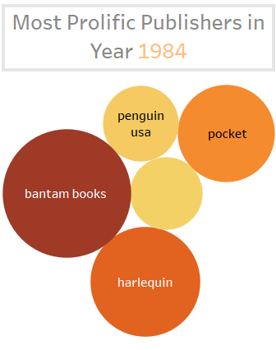
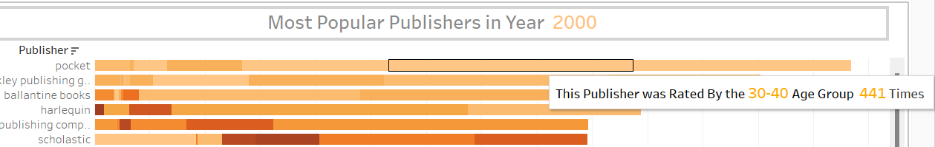
Publishing Year Data
Books from 1952
Who said kids don’t read classical literature
Harlequin Dominates
30-40 rate the most
30’s are for gaining wisdom it seems

Slide 15
Summary
Data Cleaning
What are we missing
Took majority of time but done professionally
Substantial data on Asia and other areas could prove to be highly insightful
Tableau
Our Team
Quite simple to understand and versatile.
Proved successful in this project, We are 100% sure Amir won't be disappointed.
Findings
Kids read old classic books
Countries love their own authors but not exclusively
Seems like Iran reads a lot, compared to her neighbors

Slide 16

Thank you
Amir, for your patience, your cool, and your humor.
Thanks for an intensely enriching course.
The Boys

